Slide 1
M23DES221- ARTIFICIAL INTELLIGENCE
Academic Year: 2024-2025 (Even Semester)
MCA II Semester, School of CSA
Dr. Rajeev Ranjan
Associate Professor

Slide 2
COURSE CONTENT
UNIT 2
Adversarial search: Games, mini-max algorithm, optimal decisions in multiplayer games, Problems in Game playing, Alpha-Beta pruning
Knowledge Representation: Knowledge-Based Agent, Knowledge Representation, Knowledge Representation Techniques, Propositional Logic, First-order logic, Knowledge Engineering in FOL, Inference in First-Order Logic, Forward Chaining, and backward chaining.
Symbolic Reasoning under Uncertainty: Introduction to Nonmonotonic Reasoning; Logics for Nonmonotonic Reasoning, Default Reasoning and Minimalist Reasoning

Slide 3
Adversarial search
Adversarial search is a search, where we examine the problem which arises when we try to plan ahead of the world and other agents are planning against us.
is a problem-solving technique focusing on making decisions in competitive or adversarial scenarios.
It is employed to find optimal strategies when multiple agents, often called players, have opposing or conflicting objectives.
Adversarial search aims to determine the best course of action for a given player, considering the possible moves and counter-moves of the opponent(s).

Slide 4
In previous topics, we have studied the search strategies that are only associated with a single agent that aims to find the solution, often expressed as a sequence of actions.
But, there might be some situations where more than one agent is searching for the solution in the same search space, and this situation usually occurs in game playing.
The environment with more than one agent is termed a multi-agent environment, in which each agent is an opponent of another agent and playing against each other. Each agent needs to consider the actions of other agents and the effect of those actions on their performance.
So, Searches in which two or more players with conflicting goals are trying to explore the same search space for the solution, are called Adversarial searches, often known as Games.
Games are modeled as a Search problem and heuristic evaluation function, and these are the two main factors that help to model and solve games in AI.

Slide 5
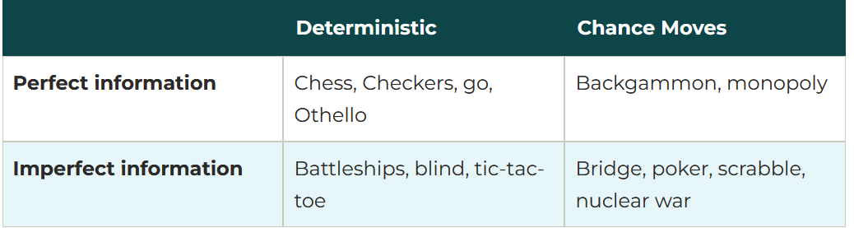
Types of Games in AI:

Slide 6
Perfect information:
A game with the perfect information is one in which agents can look into the complete board. Agents have all the information about the game, and they can see each other moves also.
Examples are Chess, Checkers, Go, etc.
Imperfect information: If in a game agents do not have all information about the game and are not aware of what's going on, such types of games are called games with imperfect information, such as tic-tac-toe, Battleship, blind, Bridge, etc.
Deterministic games: Deterministic games are those games that follow a strict pattern and set of rules for the games, and there is no randomness associated with them. Examples are chess, Checkers, Go, tic-tac-toe, etc.
Non-deterministic games: Non-deterministic are those games that have various unpredictable events and have a factor of chance or luck. This factor of chance or luck is introduced by either dice or cards. These are random, and each action response is not fixed. Such games are also called stochastic games.
Example: Backgammon, Monopoly, Poker, etc.

Slide 7
Zero-Sum Game
Zero-sum games are adversarial search that involves pure competition.
In a Zero-sum game each agent's gain or loss of utility is exactly balanced by the losses or gains of utility of another agent.
One player of the game tries to maximize one single value, while the other player tries to minimize it.
Each move by one player in the game is called a ply.
Chess and tic-tac-toe are examples of a Zero-sum game.
Zero-sum game: Embedded thinking
The Zero-sum game involved embedded thinking in which one agent or player is trying to figure out:
What to do.
How to decide the move
Needs to think about his opponent as well
The opponent also thinks about what to do
Each of the players is trying to find out the response of his opponent to their actions. This requires embedded thinking or backward reasoning to solve the game problems in AI.

Slide 8
Formalization of the problem:
A game can be defined as a type of search in AI that can be formalized by the following elements:
S0: The initial state, which specifies how the game is set up at the start.
PLAYER(s): Defines which player has the move in a state.
ACTIONS(s): Returns the set of legal moves in a state.
RESULT(s, a): The transition model, which defines the result of a move.
TERMINAL-TEST(s): A terminal test, which is true when the game is over and false otherwise. States where the game has ended are called terminal states.
UTILITY(s, p):
A utility function (also called an objective function or payoff function), defines the final numeric value for a game that ends in terminal state s for a player p. In chess, the outcome is a win, loss, or draw, with values +1, 0, or 1/2.
Some games have a wider variety of possible outcomes; the payoffs in backgammon range from 0 to +192.

Slide 9
Game tree
A game tree is a tree where nodes of the tree are the game states and Edges of the tree are the moves by players.
Game tree involves initial state, actions function, and result Function.
Example: Tic-Tac-Toe game tree:
The following figure shows part of the game tree for the tic-tac-toe game.
Following are some key points of the game:
There are two players MAX and MIN.
Players have an alternate turn and start with MAX.
MAX maximizes the result of the game tree
MIN minimizes the result.

Slide 10
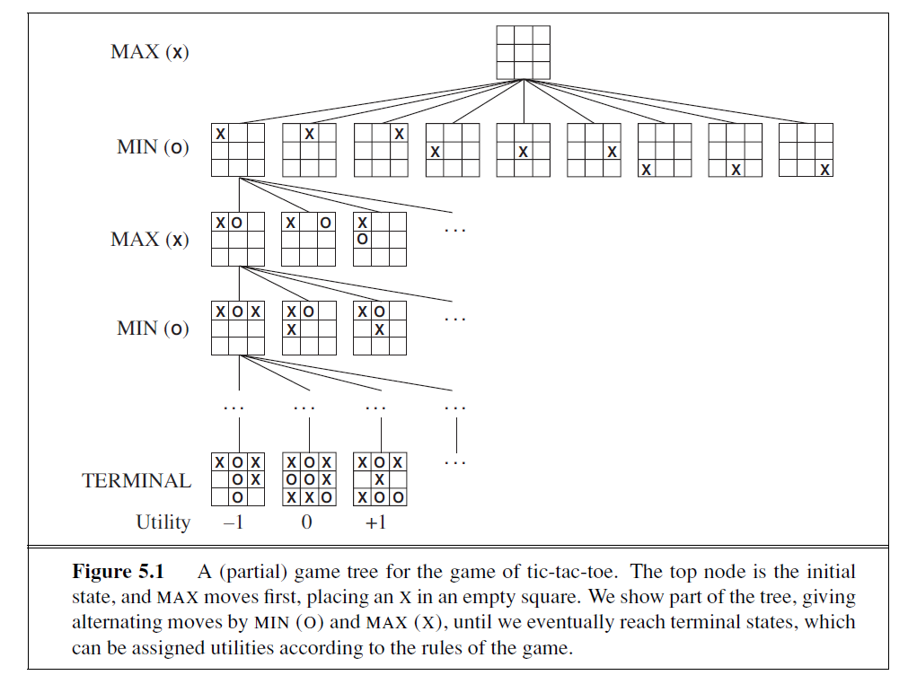

Slide 11
Example Explanation:
From the initial state, MAX has 9 possible moves as he starts first. MAX place x and MIN place o, and both player plays alternatively until we reach a leaf node where one player has three in a row or all squares are filled.
Both players will compute each node, minimax, the minimax value which is the best achievable utility against an optimal adversary.
Suppose both the players are well aware of the tic-tac-toe and playing the best play. Each player is doing his best to prevent another one from winning. MIN is acting against Max in the game.
So in the game tree, we have a layer of Max and a layer of MIN, and each layer is called Ply. Max places x, then MIN puts o to prevent Max from winning, and this game continues until the terminal node.
In this either MIN wins, MAX wins, or it's a draw.
This game tree is the whole search space of possibilities where MIN and MAX are playing tic-tac-toe and taking turns alternately.

Slide 12
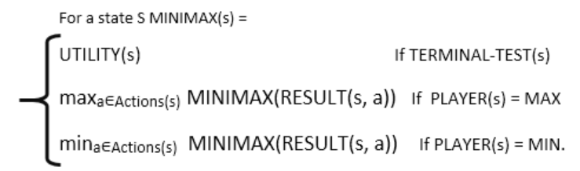
Optimal decisions in games
Hence adversarial Search for the minimax procedure works as follows:
It aims to find the optimal strategy for MAX to win the game.
It follows the approach of Depth-first search.
In the game tree, the optimal leaf node could appear at any depth of the tree.
Propagate the minimax values up to the tree until the terminal node is discovered.
In a given game tree, the optimal strategy can be determined from the minimax value of each node, which can be written as MINIMAX(n). MAX prefer to move to a state of maximum value and MIN prefers to move to a state of minimum value then:

Slide 13
Minimax algorithm
Mini-max algorithm is a recursive or backtracking algorithm that is used in decision-making and game theory.
It provides an optimal move for the player assuming that the opponent is also playing optimally.
The mini-Max algorithm uses recursion to search through the game tree.
The Min-Max algorithm is mostly used for game playing in AI. such as Chess, Checkers, tic-tac-toe, go, and various tow-players game.
This Algorithm computes the minimax decision for the current state.
In this algorithm two players play the game, one is called MAX and the other is called MIN.
Both the players fight it as the opponent player gets the minimum benefit while they get the maximum benefit.
Both Players of the game are opponents of each other, where MAX will select the maximized value and MIN will select the minimized value.
The minimax algorithm performs a depth-first search algorithm for the exploration of the complete game tree.

Slide 14
In these games, each player wants to make the best or most optimal move to maximize their chances of winning, while also trying to minimize their opponent’s chances.
These two actions, maximize and minimize, are combined to form the algorithm’s name.
This algorithm helps the computer or AI decide its next move by considering all possible moves it can make and all possible responses from the opponent. It does this by simulating the game’s future moves and outcomes.

Slide 15
Mini max algorithm
The algorithm helps in selecting the move that minimizes the maximum possible loss.
The Min Max algorithm has many applications in game AI, decision-making, and optimization.
The minimax algorithm computes the minimax decision from the current state.
It uses a simple recursive computation of the minimax values of each successor state, directly implementing the defining equations.
The recursion proceeds down to the leaves of the tree, and then the minimax values are backed up through the tree as the recursion unwinds.

Slide 16
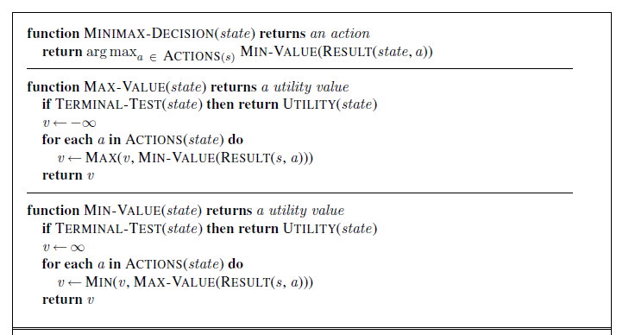
Min max algorithm
An algorithm for calculating minimax decisions.
It returns the action corresponding to the best possible move, that is, the move that leads to the outcome with the best utility, under the assumption that the opponent plays to minimize utility.
The functions MAX-VALUE and MIN-VALUE go through the whole game tree, all the way to the leaves, to determine the backed-up value of a state. The notation argmaxa∈ S f(a) computes the element a of set S that has the maximum value of f(a).

Slide 17
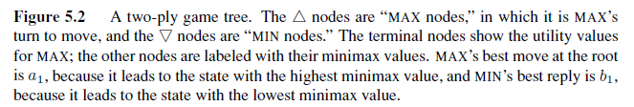
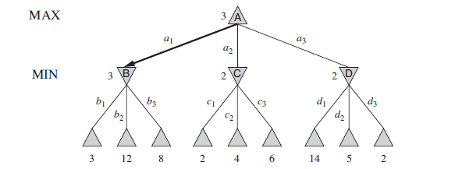
example
The algorithm first recurses down to the three bottom left nodes and uses the UTILITY function on them to discover that their values are 3, 12, and 8, respectively.
Then it takes the minimum of these values, 3, and returns it as the backed up value of node B.
A similar process gives the backed-up values of 2 for C and 2 for D.
Finally, we take the maximum of 3, 2, and 2 to get the backed-up value of 3 for the root node.

Slide 18
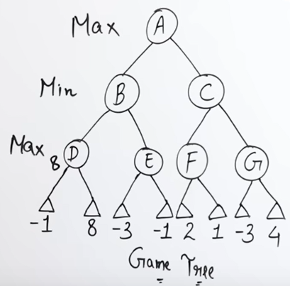
Example 2

Slide 19
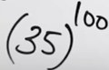
Limitation of minimax algorithm
The minimax algorithm performs a complete depth-first exploration of the game tree.
If the maximum depth of the tree is m and there are b legal moves at each point, then the time complexity of the minimax algorithm is
The space complexity is O(bm) for an algorithm that generates all actions at once.
Suitable for less complex games like tic tac toe etc.
Not suitable for chess because
Number of child/choices = b = 35
Number of moves =d= 50 +50 =100
Total time complexity/number of nodes=

Slide 20
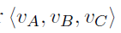
Optimal decisions in multiplayer games
Replace the single value for each node with a vector of values.
For example, in a three-player game with players A, B, and C, a vector
is associated with each node.
For terminal states, this vector gives the state’s utility from each player’s
viewpoint.
The simplest way to implement this is to have the UTILITY function return a vector of utilities.

Slide 21
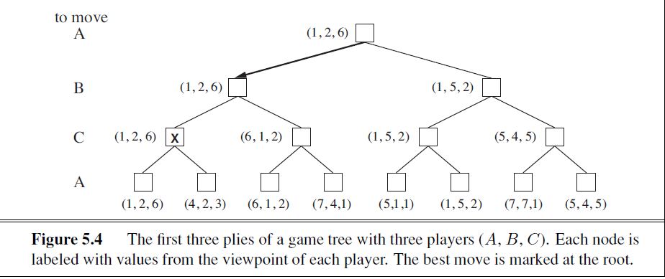
example

Slide 22
Explanation:
Now we have to consider nonterminal states. Consider the node marked X in the game tree shown in Figure. In that state, player C chooses what to do. The two choices lead to terminal states with utility vectors
Since 6 is bigger than 3, C should choose the first move. This means that if state X is reached, subsequent play will lead to a terminal state with utilities 〈uA = 1, uB = 2, uC = 6. Hence, the backed-up value of X is this vector.
The backed-up value of a node n is always the utility vector of the successor state with the highest value for the player choosing at n.

Slide 23
ALPHA–BETA PRUNING
The problem with minimax search is that the number of game states it has to examine is exponential in the depth of the tree.
Alpha Beta Pruning is an optimization technique of the Minimax algorithm. This algorithm solves the limitation of exponential time and space complexity in the case of the Minimax algorithm by pruning redundant branches of a game tree using its parameters Alpha(α) and Beta(β).
Parameter of the Alpha Beta Pruning Algorithm
Alpha(α): The best choice(highest utility/value) found till the current state on the path traversed by the maximizer.
Beta(β): The best choice(lowest utility/value) found till the current state on the path traversed by the minimizer.

Slide 24
Salient Properties and Conditions of the Alpha Beta Pruning Algorithm
Alpha: Alpha is the best choice or the highest value that we have found at any instance along the path of Maximizer. The initial value for alpha is – ∞.
Beta: Beta is the best choice or the lowest value that we have found at any instance along the path of Minimizer. The initial value for alpha is + ∞.
The condition for Alpha-beta Pruning is that α >= β.
Each node has to keep track of its alpha and beta values. Alpha can be updated only when it’s MAX’s turn and, similarly, beta can be updated only when it’s MIN’s chance.
MAX will update only alpha values and MIN player will update only beta values.
The node values will be passed to upper nodes instead of values of alpha and beta during go into reverse of tree.
Alpha and Beta values only be passed to child nodes.

Slide 25
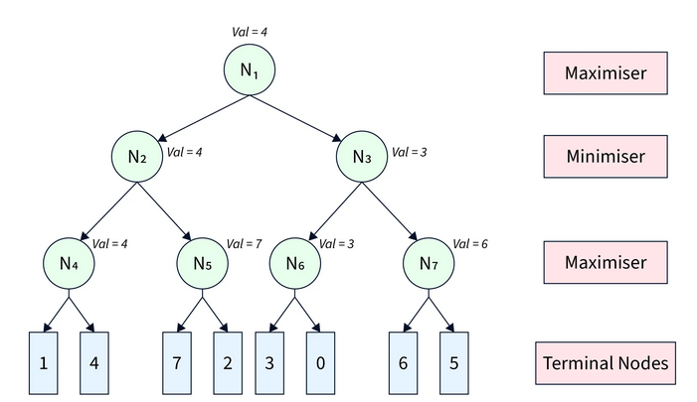
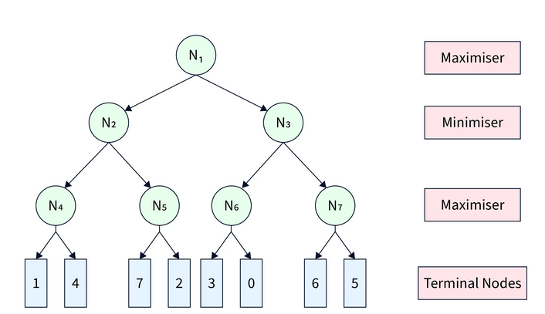
example
Traversing of minimax algorithm

Slide 26
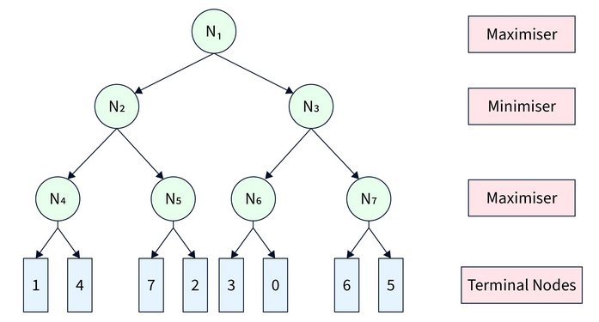
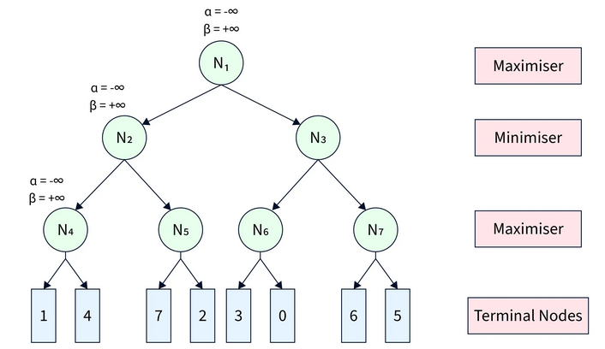
Figure 1
Alpha Beta Pruning algorithm restricts the agent from visiting redundant sub-trees leading to faster average search time complexity.
To visualize its working, we refer to the same game tree in Figure 1.
We start from node N1​ with α=−∞ and β=∞. From N1​, we move to its child node N2​ with the same α and β.
Similarly, we move from N2 to its child N4​, as shown in Figure 2.
Figure 2

Slide 27
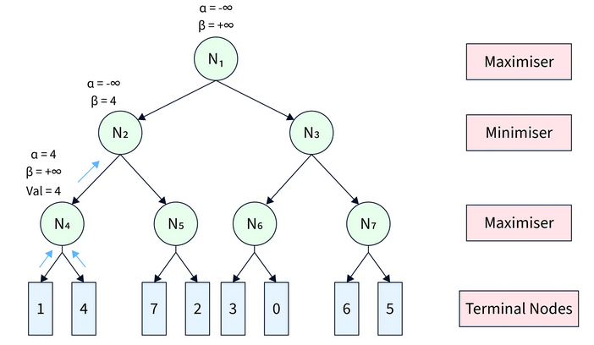
From N4​, we move to its first terminal child and get back its utility as 1.
Since N4 is a maximizer, we update α=max(−∞,1)=1.
The pruning condition α≥β remains unsatisfied. Therefore, we move to the second terminal child of N4​ and get its utility as 4.
Further, we update α=max(1,4)=4.
After this step, we get the node value of N4 as max(1,4)=4 and return it to its parent N2​. Since N2​ is a minimizer, it updates β=min(+∞,4)=4.
The game tree after this step is shown in
Figure3
Figure 3

Slide 28
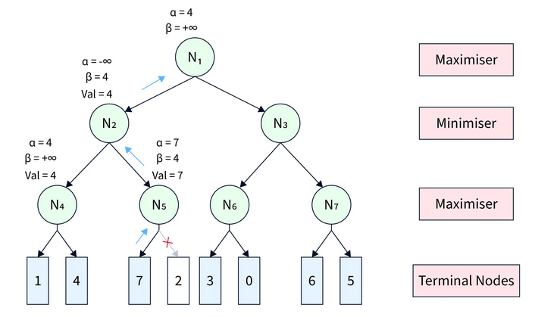
At N2​, the pruning condition α≥β is still unsatisfied. Therefore, we visit its next child node N5​ with α=−∞and β=4.
At N5​, we get the utility of its first terminal child as 7. Since N5​ is a maximizer, we update α=max(−∞,7)=7.
Now, the pruning condition gets satisfied (7≥4) leading to the pruning of the other child node.
After that, the node utility of N5=7 is further sent back to the parent node N2 ​.
N2​ updates β=min(4,7)=4.
Further, the node value of N2=min(4,7)=4 is returned to its parent N1​. At N1​, we update α=max(−∞,4)=4.
After this step, the game tree looks like Figure-4.
Figure 4

Slide 29
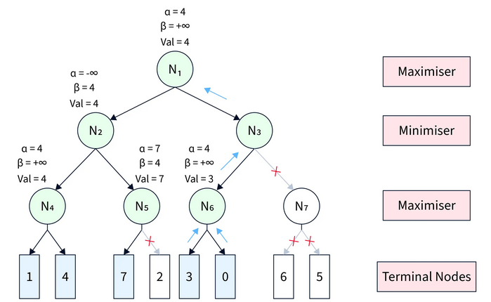
The pruning condition is still unsatisfactory at N1​. Therefore, we continue towards the next child N3​, with the same values of α and β.
Similarly, we propagate from N3 to its first child N6. At N6​, we get back the utility of its first terminal child as 3 and update α=max(4,3)=4.
Since the pruning condition is still unsatisfied, we get the utility of the second terminal child as 0 and update α=max(4,0)=4.
After this, the node value of N6=max(3,0)=3, is returned to the parent N3​. Since N3​ is a minimizer, we update β=min(+∞,3)=3.
Now, the pruning condition is satisfied (4≥3).
Therefore, the other child sub-tree(rooted at N7​)
of N3​ is pruned, and the node value of N3​ becomes 3,
which is returned to parent N1​.
At N1​, we again update α=max(4,3)=4 and the
final utility of N1​ becomes 4.
All these steps are shown in Figure-5.
Figure 5

Slide 30
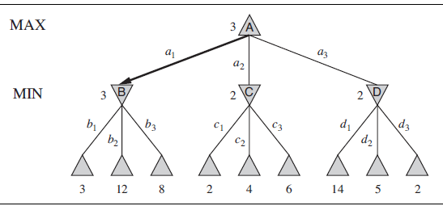
Example 2:

Slide 31
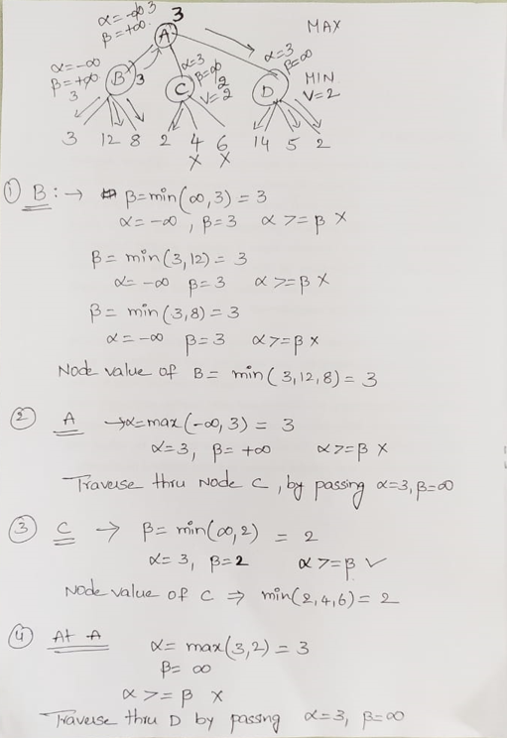
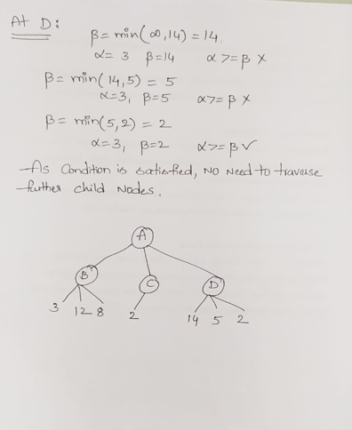

Slide 32
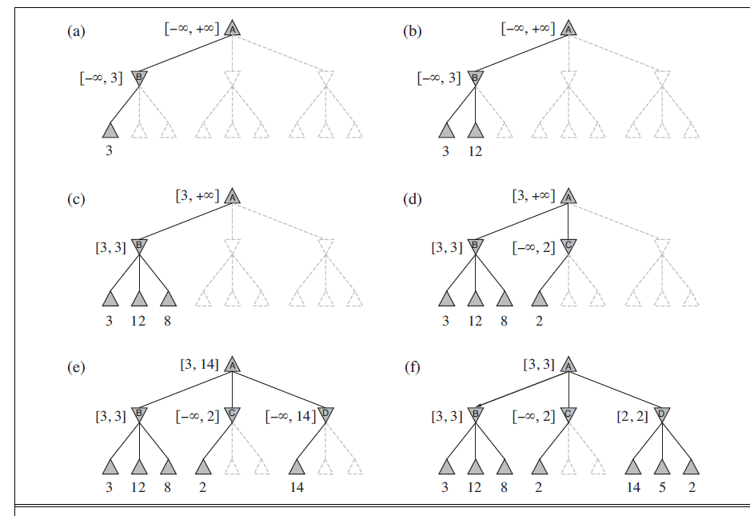
Example 2: Solution

Slide 33
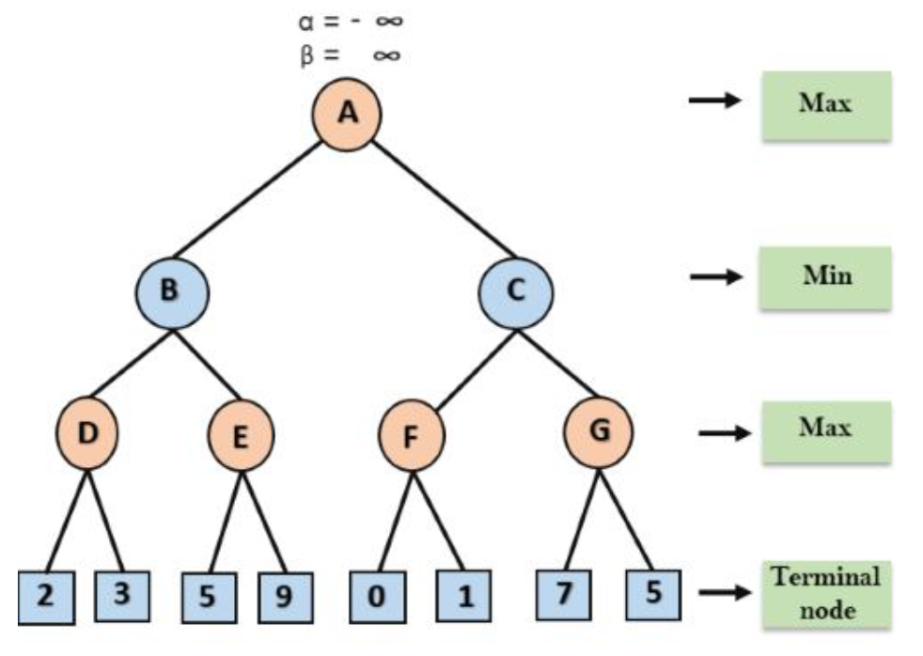
Example 3- alpha beta pruning

Slide 34
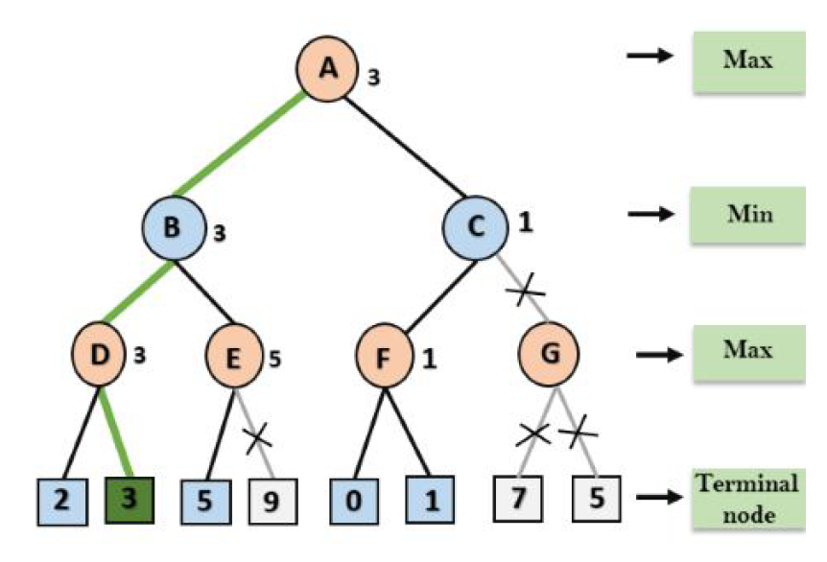
Example 2
Solution

Slide 35
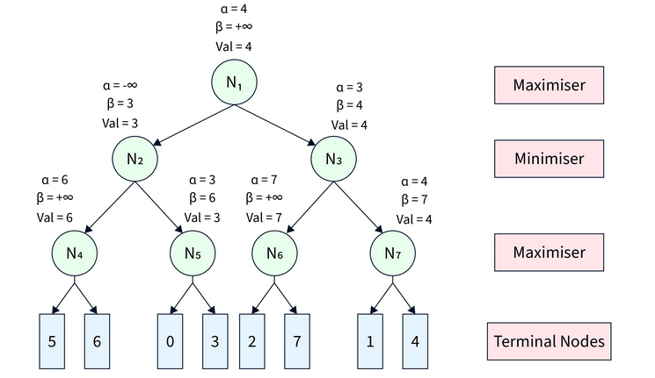
Move Ordering in Alpha Beta pruning in AI
The performance of the Alpha Beta Pruning algorithm is highly dependent on the order in which the nodes are traversed. For instance,
Case-1(Worst Performance): If the best sequence of actions is on the right of the game tree, then there will be no pruning, and all the nodes will be traversed, leading to even worse performance than the Minimax algorithm because of the overhead of computing α and β. An example game tree can be seen in Figure

Slide 36
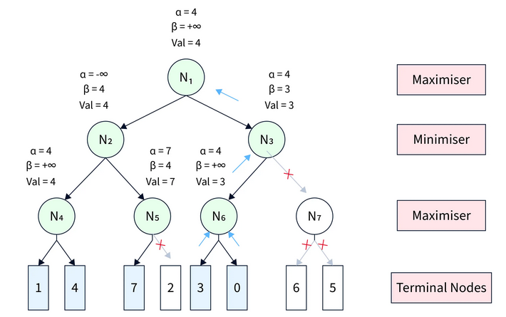
Case-2(Best Performance): If the best sequence of actions is on the left of the game tree, there will be a lot of pruning, and only about half of the nodes will be traversed to get the optimal result. An example game tree can be seen in Figure

Slide 37
Rules to Find Good Ordering
The best move occurs from the shallowest node.
The game tree is ordered so that the best nodes are checked first.
Domain knowledge is used to find the best move.
Memorization is applied to prevent re-computation in case of repeating states.

Slide 38
Knowledge-Based Agent
Knowledge-based agents are artificial intelligence systems using knowledge to perform tasks.
For example, they make deductions, decisions, and conclusions based on available knowledge.
Knowledge-based agents are essential in several fields, including
medicine,
engineering, and
finance,
where they are used to solve complex problems

Slide 39
Knowledge-Based Agents are Composed of Two Main Parts
Knowledge-Base
is a collection of knowledge that the agent uses to make decisions.
The knowledge can be explicit, such as rules or facts, or implicit, such as relationships or patterns.
The knowledge base is stored in a database or a knowledge representation system.
Inference System
The inference system of a knowledge-based agent is responsible for using the knowledge in the knowledge base to make decisions.
The inference system uses reasoning methods, such as deduction, induction, and abduction, to infer new knowledge from existing knowledge.

Slide 40
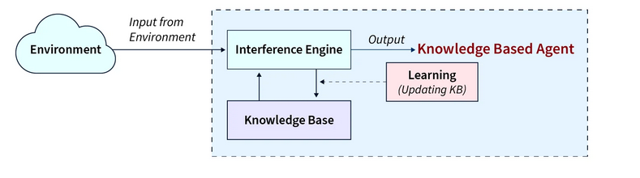
The Architecture of Knowledge-Based Agent
The KBA receives input from the environment through perception, which the inference engine processes.
The inference engine communicates with the knowledge base (KB) to determine the appropriate action based on the knowledge stored in the KB.
The learning element of the KBA regularly updates the KB by incorporating new knowledge.

Slide 41
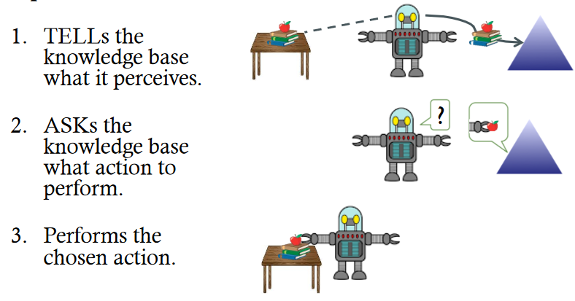
1) Knowledge Base:
The central component of a knowledge-baed agent is its knowledge base, or KB.
A knowledge base is a set of sentences.
Each sentence is expressed in a knowledge representation language and represents some assertion about the world.
There must be a way to add new sentences to the knowledge base and a way to query what is known. The standard names for these operations are TELL and ASK, respectively. KB operates as follows:

Slide 42
2) Inference System
The inference system of a knowledge-based agent is responsible for using the knowledge in the knowledge base to make decisions.
The inference system uses reasoning methods, such as deduction, induction, and abduction, to infer new knowledge from existing knowledge.
Generating new facts by the inference system allows the agent to update its knowledge base.
The inference system operates primarily through two rules, which are referred to as forward chaining and backward chaining.

Slide 43
Operations Performed by KBA
three main operations that a knowledge-based agent (KBA) performs to demonstrate intelligent behavior.
The first operation is called TELL, where the KBA informs the knowledge base about the information it has perceived from the environment.
The second operation is called ASK, where the KBA requests the knowledge base to suggest appropriate action.
The third operation is PERFORM, where the KBA executes the selected action.

Slide 44
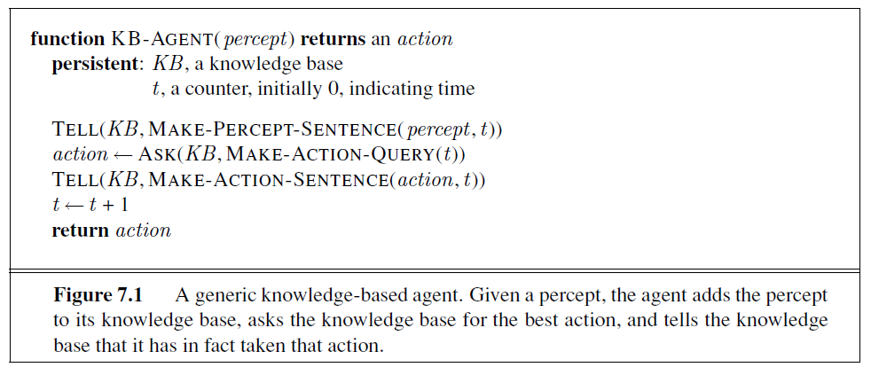
MAKE-PERCEPT-SENTENCE constructs a sentence asserting that the agent perceived the given percept at the given time.
MAKE-ACTION-QUERY constructs a sentence that asks what action should be taken now. Finally,
MAKE-ACTION-SENTENCE constructs a sentence asserting that the chosen action was executed.
The details of the inference mechanisms are hidden inside TELL and ASK.

Slide 45
Various Levels of Knowledge-Based Agent
Knowledge Level.
The most abstract level: describe the agent by saying what it knows.
Example: For example, suppose an automated taxi agent needs to go from station A to station B, and he knows the way from A to B, so this comes at the knowledge level.
Logical Level.
The level at which the knowledge is encoded into sentences.
Example: Links(A,B).
Implementation Level.
The physical representation of the sentences at the logical level.
Example: At this level, an automated taxi agent implements his knowledge and logic so that he can reach the destination.

Slide 46
Approaches to Designing a Knowledge-Based Agent
Two main approaches to designing a knowledge-based agent:
The declarative Approach
focuses on representing knowledge in a declarative form, such as rules or facts.
The knowledge is represented independently of the algorithms used to manipulate it.
Procedural Approach
focuses on representing knowledge in a procedural form, such as a sequence of instructions.
The knowledge is represented in terms of the algorithms used to manipulate it.
The inference engine uses these algorithms to make inferences from the knowledge.

Slide 47

Knowledge Representation
Concept

Slide 48
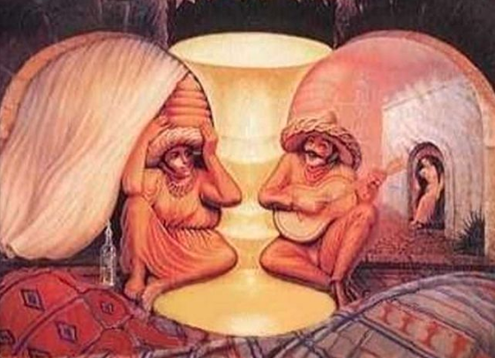
Knowledge Representation
Concept

Slide 49
Knowledge Representation
Concept
Human beings are good at understanding, reasoning and interpreting knowledge.
And using this knowledge, they are able to perform various actions in the real world.
But how do machines perform the same?
we will learn about Knowledge Representation in AI and how it helps the machines perform reasoning and interpretation using Artificial Intelligence

Slide 50
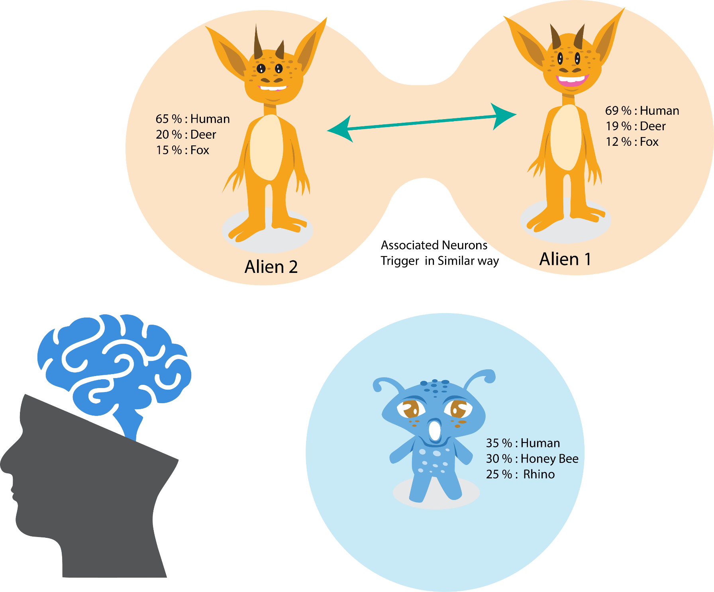
Knowledge Representation
Concept
Representation of Knowledge : KR
Human – neurons
Computer – Digital (binary)

Slide 51
Knowledge
Definition
Knowledge is awareness or familarity gained by experience of facts, data and situtations
Basically, it is a study of how the beliefs, intentions, and judgments of an intelligent agent can be expressed suitably for automated reasoning

Slide 52
The Different Kinds of Knowledge: What to Represent
Object: The AI needs to know all the facts about the objects in our world domain. E.g., A keyboard has keys, a guitar has strings, etc.
Events: The actions which occur in our world are called events.
Performance: It describes a behavior involving knowledge about how to do things.
Meta-knowledge: The knowledge about what we know is called meta-knowledge.
Facts: The things in the real world that are known and proven true.
Knowledge Base: A knowledge base in artificial intelligence aims to capture human expert knowledge to support decision-making, problem-solving, and more.

Slide 53
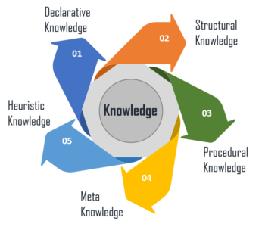
Types of Knowledge in AI
Knowledge can refer to a theoretical or practical understanding of a subject
Notes:
Ref: Wikipedia & javapoint.com

Slide 54
Types of Knowledge in AI
1) Declarative Knowledge:
This knowledge can be expressed in a declarative form, such as facts, rules, or propositions.
It is also called descriptive knowledge and is expressed in declarative sentences.
It is often represented using logic-based representations such as knowledge graphs or ontologies.
Example: The capital of France is Paris.
This statement represents declarative knowledge because it is a fact that can be explicitly stated and written down.
It is not based on personal experience or practical skills, but rather on an established piece of information that can be easily communicated to others.

Slide 55
Types of Knowledge in AI
2) Procedural Knowledge:
This knowledge is used to perform specific tasks or actions
represented using algorithms or programming languages.
It is responsible for knowing how to do something.
It includes rules, strategies, procedures, agendas, etc.
Example: How to change a flat tire on a car,
including the steps of
loosening the lug nuts,
jacking up the car,
removing the tire, and
replacing it with a spare.
This is a practical skill that involves specific techniques and steps that must be followed to successfully change a tire.

Slide 56
3) Meta-knowledge:
This is knowledge about knowledge
used to reason about and improve the performance of AI systems.
Example: To remember new information, it is helpful to use strategies such as repetition, visualization, and elaboration. This statement represents metaknowledge because it is knowledge about learning and remembering new information, rather than about a specific fact or concept.
It acknowledges that some specific techniques and strategies can be used to enhance memory and learning, and encourages the use of these techniques to improve learning outcomes.

Slide 57
Types of Knowledge in AI
4) Heuristic Knowledge:
Heuristics are based on past experiences or domain knowledge
used in decision-making processes to guide an AI system toward a solution.
Heuristic knowledge is a type of knowledge in AI that refers to rules of thumb or strategies that are used to solve problems quickly and efficiently, but only sometimes optimally.
Heuristics are often used when there is too much complexity or uncertainty in a problem to use an exact algorithm or solution.
Example: When packing for a trip, it is helpful to make a list of essential items, pack versatile clothing items that can be mixed and matched, and leave room in the suitcase for any souvenirs or purchases.
This statement represents heuristic knowledge because it is a practical set of rules of thumb that can be used to guide decision-making in a specific situation (packing for a trip).

Slide 58
Types of Knowledge in AI
5) Structural Knowledge:
This is knowledge about the structure of a problem or system
used to help AI systems decompose complex problems into simpler sub-problems that can be solved more easily.
It is the basic knowledge of problem-solving.
It also describes relationships between concepts such as kind of, part of, and grouping of something.
Example: In the field of biology, living organisms can be classified into different taxonomic groups based on shared characteristics. These taxonomic groups include domains, kingdoms, phyla, classes, orders, families, genera, and species.
This statement represents structural knowledge because it describes the hierarchical structure of the taxonomic classification system used in biology. It acknowledges that there are specific levels of organization within this system and that each level has its unique characteristics and relationships to other levels.

Slide 59
Knowledge Representation
In order to solve complex problems encountered in artificial intelligence, one needs both a large amount of knowledge and some mechanism for manipulating that knowledge to create solutions.
Knowledge and Representation are two distinct entities. They play central but distinguishable roles in intelligent system.
Knowledge is a description of the world. It determines a system’s competence by what it knows.
Representation is the way knowledge is encoded. It defines a system’s performance in doing something.
Notes:
Ref: Wikipedia & javapoint.com

Slide 60
Knowledge Representation
Definition
Knowledge Representation is a field of artificial intelligence that is concerned with presenting real-world information in a form that the computer can ‘understand’ and use to ‘solve’ real-life problems or ‘handle’ real-life tasks.
The ability of machines to think and act like humans such as understanding, interpreting and reasoning constitute knowledge representation.
It is related to designing agents that can think and ensure that such thinking can constructively contribute to the agent’s behavior.
In simple words, knowledge representation allows machines to behave like humans by empowering an AI machine to learn from available information, experience or experts.
Notes:
Ref: Wikipedia & javapoint.com

Slide 61
Knowledge Representation
Importance
Knowledge representation plays a crucial role in artificial intelligence.
It has to do with the ‘thinking’ of AI systems and contributes to its intelligent behavior.
Knowledge Representation is a radical and new approach to AI that is changing the world.
Notes:
Ref: Wikipedia & javapoint.com

Slide 62
Knowledge Representation properties
Representational Adequacy:
The ability to represent all kinds of knowledge that are needed in that domain.
Inferential Adequacy:
The ability to manipulate the representational structures to derive new structures corresponding to new knowledge inferred from old.
Inferential Efficiency:
The ability to incorporate additional information into the knowledge structure that can be used to focus the attention of the inference mechanisms in the most promising direction.
Acquisitional Efficiency:
The ability to acquire new knowledge using automatic methods wherever possible rather than relying on human intervention.
Notes:
Ref: Wikipedia & javapoint.com

Slide 63
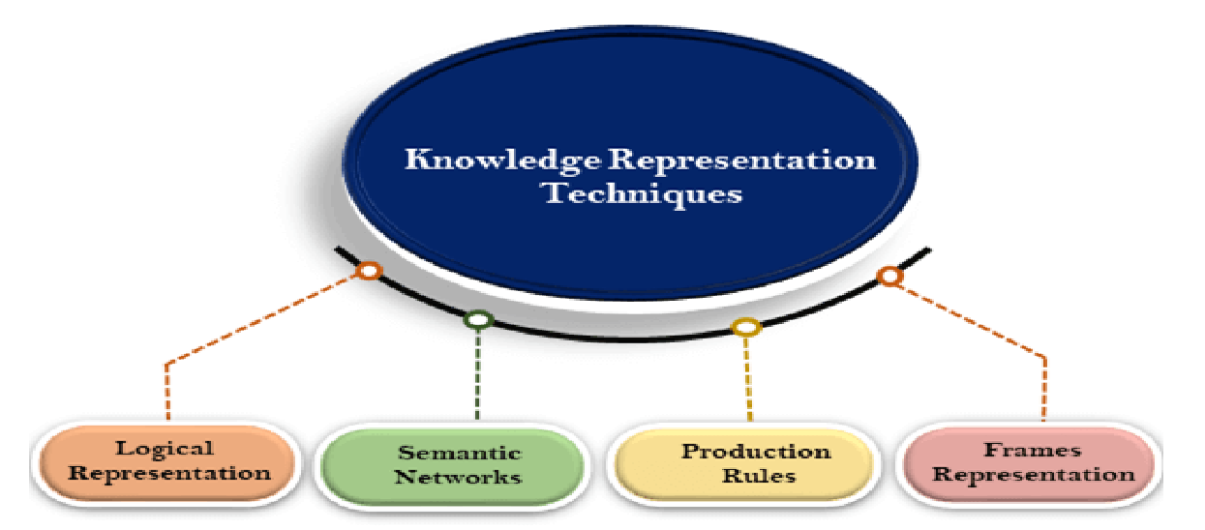
Techniques of Knowledge Representation

Slide 64
Techniques of Knowledge Representation
Logical Representation
Logical representation is a language with some concrete rules that deal with propositions and has no ambiguity in representation.
Logical representation means drawing a conclusion based on various conditions.
This representation lays down some important communication rules.
It consists of precisely defined syntax and semantics supporting sound inference.
Each sentence can be translated into logic using syntax and semantics
Syntax:
o Syntaxes are the rules that decide how we can construct legal sentences in logic.
o It determines which symbol we can use in knowledge representation.
o How to write those symbols.
Semantics:
o Semantics are the rules by which we can interpret the sentence in the logic.
o Semantic also involves assigning a meaning to each sentence

Slide 65
Techniques of Knowledge Representation
Logical representation can be categorized into mainly two logics:
Propositional Logics
Definition: Propositional Logic represents knowledge in simple, declarative statements (propositions) that can be either true or false.
Each proposition is represented by a symbol (e.g., PP, QQ) and connected by logical connectives (AND, OR, NOT, IF-THEN).
Example: Knowledge: "It is raining" and "I am carrying an umbrella."
Logical Representation:
P: It is raining.
Q: I am carrying an umbrella.
The knowledge can be represented as P∧Q (It is raining AND I am carrying an umbrella).

Slide 66
Techniques of Knowledge Representation
2. Predicate Logic (First-Order Logic - FOL):
Definition: Predicate Logic extends Propositional Logic by allowing the use of variables, functions, and quantifiers (like ∀ "for all", ∃ "there exists").
It enables more expressive representations of knowledge by describing relationships between objects and their properties.
Example:
Knowledge: "All humans are mortal" and "Socrates is a human."
Logical Representation:

Slide 67
Knowledge Representation Techniques
2. Semantic Network Representation
alternative of predicate logic for knowledge representation.
In Semantic networks, can represent our knowledge in the form of graphical networks.
This network consists of nodes representing objects and arcs which describe the relationship between those objects. Semantic networks can categorize the object in different forms and can also link those objects.
Semantic networks are easy to understand and can be easily extended.
This representation consists of mainly two types of relations:
a. IS-A relation (Inheritance)
b. Kind-of-relation

Slide 68
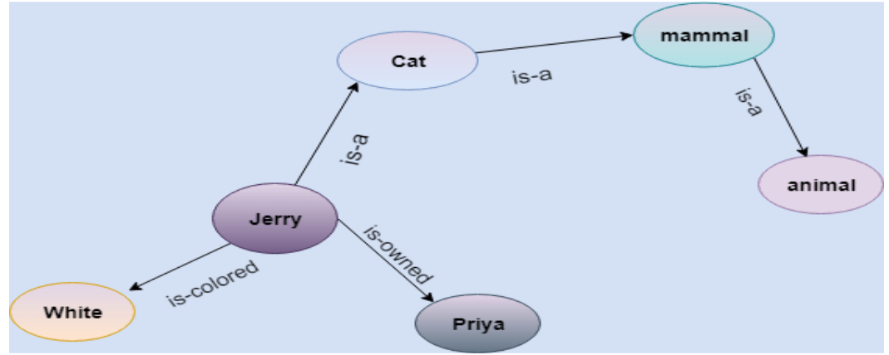
Knowledge Representation Techniques
Example:
Jerry is a cat.
Jerry is a mammal
Jerry is owned by Priya.
Jerry is white colored.
All Mammals are animal.

Slide 69
Knowledge Representation Techniques
3. Frame Representation
The structure of the frame is like a record that contains a collection of attributes and their values to describe an entity in the world.
Frames are the AI data structure that divides knowledge into substructures by representing stereotypical situations.
It consists of a collection of slots and slot values.
These slots may be of any type and sizes.
Slots have names and values which are called facets.
A frame is also known as slot-filter knowledge representation in artificial intelligence

Slide 70
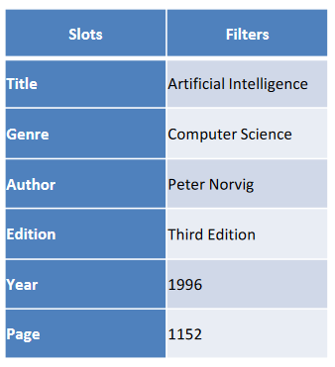
Knowledge Representation Techniques
Example: Frame for a book

Slide 71
Knowledge Representation Techniques
4. Production Rules
Production rules system consists of (condition, action) pairs which means, "If condition then action".
It has mainly three parts:
o The set of production rules
o Working Memory
o The recognize-act-cycle
In production rules agent checks for the condition and if the condition exists then the production rule fires and the corresponding action is carried out.
The condition part of the rule determines which rule may be applied to a problem. The action part carries out the associated problem-solving steps.
This complete process is called a recognize-act cycle

Slide 72
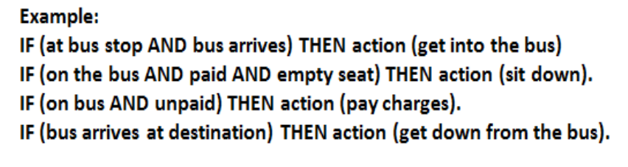
Example:

Slide 73
Logic in general
Logics are formal languages for representing information such that conclusions can be drawn
Knowledge bases consist of sentences in a formal language
Syntax
Sentences are well-formed
Semantics
The “meaning” of the sentence
The truth of each sentence with respect to each possible world (model)
E.g., the language of arithmetic
x+2 ≥ y is a sentence;
x2+y > {} is not a sentence
x+2 ≥ y is true if the number x+2 is no less than the number y
x+2 ≥ y is true in a world where x = 7, y = 1
x+2 ≥ y is false in a world where x = 0, y = 6

Slide 74
Entailment means that one thing follows logically from another:
KB ╞ α
Knowledge base KB entails sentence α if and only if α is true in all worlds where KB is true
E.g., the KB containing “the Phillies won” and “the Reds won” entails “Either the Phillies won or the Reds won”
E.g., x+y = 4 entails 4 = x+y
Entailment is a relationship between sentences (i.e., syntax) that is based on semantics

Slide 75
Entailment
means that one thing follows logically from another
α |= β
α |= β iff in every model in which α is true, β is also true
if α is true, then β must be true
the truth of β is “contained” in the truth of α
Example:
A KB containing
“Cleveland won”
“Dallas won”
Entails…
“Either Cleveland won or Dallas won”
Example:
x + y = 4 entails 4 = x + y

Slide 76
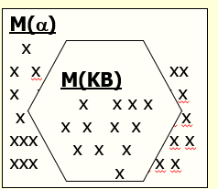
Models
Logicians typically think in terms of models, which are formally structured worlds for which truth can be evaluated
We say m is a model of a sentence α if α is true in m
M(α) is the set of all models of α
Then KB ╞ α iff M(KB) ⊆ M(α)
E.g. KB = Phillies won and
Yankees won α = Phillies won

Slide 77
Propositional Logic
The syntax of propositional logic defines the allowable sentences.
The atomic sentences consist of a single proposition symbol.
Each such symbol stands for a proposition that can be true or false.
AKA Boolean Logic
Proposition symbols P1, P2, etc. are sentences
Complex sentences are constructed from simpler sentences, using parentheses and logical connectives. There are five connectives in common use:
NOT: If S1 is a sentence, then ¬S1 is a sentence (negation)
AND: If S1, S2 are sentences, then S1 ∧ S2 is a sentence (conjunction)
OR: If S1, S2 are sentences, then S1 ∨ S2 is a sentence (disjunction)
IMPLIES: If S1, S2 are sentences, then S1 ⇒ S2 is a sentence (implication)
IFF: If S1, S2 are sentences, then S1 ⇔ S2 is a sentence (biconditional)

Slide 78
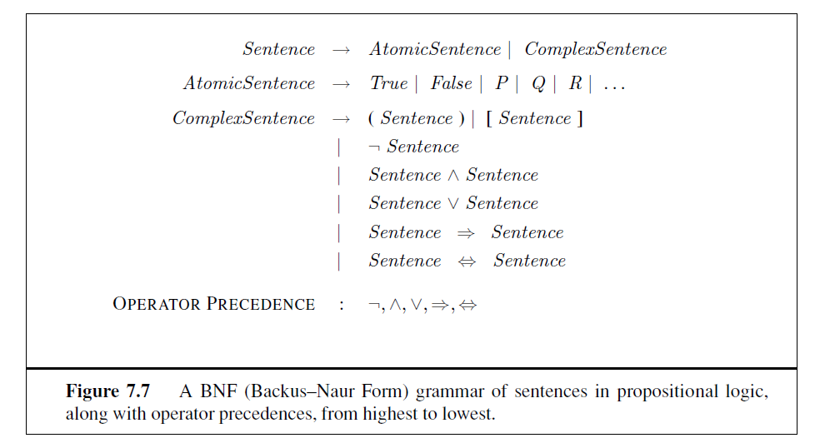

Slide 79
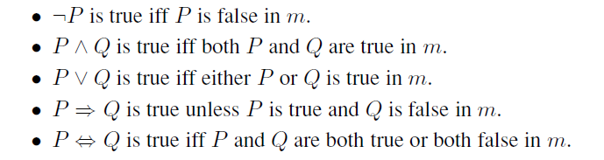
Semantics
The semantics defines the rules for determining the truth of a sentence concerning a particular model.
In propositional logic, a model simply fixes the truth value—true or false for every proposition symbol.
For complex sentences, we have five rules, which hold for any subsentences P and Q in any
model m (here “iff” means “if and only if”):

Slide 80
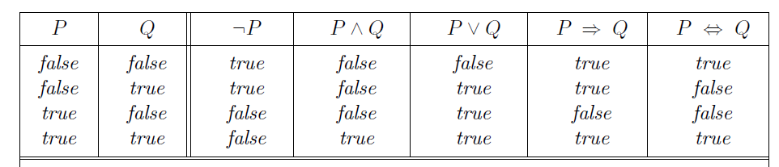
The rules can also be expressed with truth tables that specify the truth value of a complex sentence for each possible assignment of truth values to its components.
Truth tables for the five connectives are given in Figure

Slide 81
Key areas where propositional logic is applied:
Knowledge Representation:
AI systems use propositional logic to represent facts about the world. For example, in an AI system for medical diagnosis, you might have propositions such as:
P: "Patient has fever"
Q: "Patient has cough"
Using logical rules, you can infer new knowledge such as:
P ∧ Q → R (If the patient has a fever and cough, then the patient may have the flu).

Slide 82
Key areas where propositional logic is applied:
2. Inference:
Logical inference is a method of deriving new information from known propositions. AI systems use inference rules such as Modus Ponens:
If P → Q and P is true, then Q must be true.
Example:
P: "It is raining"
Q: "The ground will be wet"
P → Q: If it is raining, the ground will be wet.
If the system knows P is true, it can infer that Q is also true (the ground is wet).

Slide 83
Key areas where propositional logic is applied
3. Decision Making:
In decision-making systems, propositional logic models the rules that guide decision processes.
A robot, for example, can be programmed to perform actions based on certain logical conditions:
If P: "Battery is low" and Q: "Charging station is available", then the robot can infer that it should move to the charging station
(Action → Move to station).

Slide 84
First-order logic
Also known as Predicate Logic or First-Order Predicate Logic,
is an extension of propositional logic that adds expressiveness by allowing the representation of objects, their properties, and the relationships between them.
This framework enables more complex reasoning than propositional logic.

Slide 85
Components of First-Order Logic
Constants: Objects or individuals in the domain of discourse.
Example: John, 2, Paris.
Variables: Represent arbitrary elements of the domain.
Example: x, y, z.
Predicates: Represent properties or relationships between objects.
Example: Brother(John, Mark), Loves(x, y).
Functions: Map objects to other objects.
Example: Mother(John) refers to the mother of John.
Quantifiers:
Universal Quantifier ( ∀ ): Indicates that the proposition applies to all individuals in the domain.
Example: ∀x Human(x) → Mortal(x) ("All humans are mortal").
Existential Quantifier ( ∃ ): Indicates that there exists at least one individual for which the proposition is true.
Example: ∃x Human(x) ∧ Loves(x, Music) ("There exists a human who loves music").
Logical Connectives: The same as propositional logic (negation, conjunction, disjunction, implication, biconditional).

Slide 86
Syntax and Semantics
Syntax:
Defines the rules for forming well-formed sentences in FOL.
Sentences are constructed using constants, variables, predicates, functions, and quantifiers.
Example of an FOL statement:
∀x (Human(x) → Mortal(x))
This means "For all x, if x is a human, then x is mortal."
Semantics:
Provides meaning to sentences by interpreting the domain of discourse, where constants, predicates, and functions refer to specific entities and relationships.

Slide 87
Knowledge Engineering in First-Order Logic (FOL)
involves building a system that can represent and reason about knowledge using the structure provided by FOL.
It is the foundation for creating intelligent agents operating in complex environments.
Steps for Knowledge Engineering in FOL
Identify the Task
Assemble the Relevant Knowledge
Decide on a Vocabulary of Predicates, Functions, and Constants
Encode General Knowledge about the Domain
Encode a Description of the Specific Problem Instance
Pose Queries to the Inference System
Debug the Knowledge Base

Slide 88
Knowledge Engineering in First-Order Logic (FOL)
Identify the Task The first step in knowledge engineering is to identify the task that the intelligent agent must perform. This involves defining the problem domain and understanding the kind of reasoning that is required to solve problems in that domain.
Example: If the task is a medical diagnosis, the goal might be to identify diseases based on observed symptoms.
2. Assemble the Relevant Knowledge Next, gather the relevant knowledge about the domain. This might include facts about the world, rules that govern relationships between objects, and assumptions that are generally valid within the domain.
Example: In a medical diagnosis system, the knowledge might consist of symptoms of diseases, relationships between diseases and treatments, and facts about patients.

Slide 89
Knowledge Engineering in First-Order Logic (FOL)
3. Decide on a Vocabulary of Predicates, Functions, and Constants
This step involves defining the formal symbols that will represent objects, relationships, and properties in the domain. These symbols are crucial because they form the basis of how knowledge is represented.
Constants: Specific objects or entities in the domain (e.g., John, Socrates).
Predicates: Represent properties of objects or relationships between objects (e.g.,
HasSymptom(John, Fever) or Loves(Socrates, Philosophy)).
Functions: Map objects to other objects (e.g., Mother(John) returns John’s mother).
Example: In the medical domain:
Patient(x) represents an individual being a patient.
HasSymptom(x, y) where x is a patient and y is a symptom.
Disease(x) represents a particular disease.
Treats(x, y) represents a relationship between a treatment x and a disease y.

Slide 90
4. Encode General Knowledge about the Domain
General knowledge consists of rules and facts that hold true across various situations. In FOL, these rules can be encoded using quantifiers and logical connectives.
Example:
∀x (HasSymptom(x, Fever) ∧ HasSymptom(x, Cough) → HasDisease(x, Flu))
("For all individuals x, if x has a fever and a cough, then x has the flu.")
5. Encode a Description of the Specific Problem Instance
After encoding the general rules, you encode the specific facts that are true for the particular problem instance. This includes the actual observations or facts about the case the agent is currently dealing with.
Example:
HasSymptom(John, Fever)
HasSymptom(John, Cough)
These sentences describe that John is a patient who has both a fever and a cough.

Slide 91
6. Pose Queries to the Inference System
After building the knowledge base, you can query the system to infer new information.
Queries are typically framed as logical expressions, and the agent uses inference techniques such as modus ponens, unification, and resolution to deduce answers from the knowledge base.
Example Query:
HasDisease(John, Flu)?
This query checks whether the agent can infer that John has the flu based on the symptoms and rules in the knowledge base.
7. Debug the Knowledge Base
Knowledge engineering often involves iterative refinement.
After posing queries and examining the results, the knowledge base may need to be revised to ensure correctness, completeness, and consistency.
You might add more rules, refine existing ones, or include more specific facts.

Slide 92
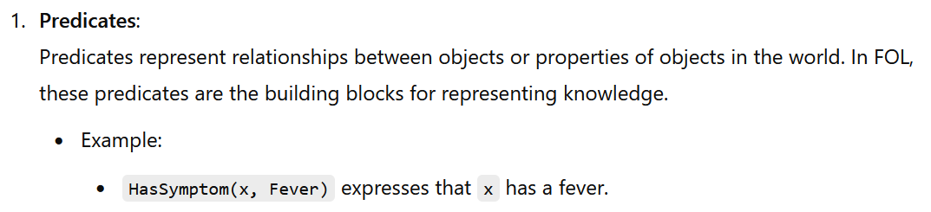
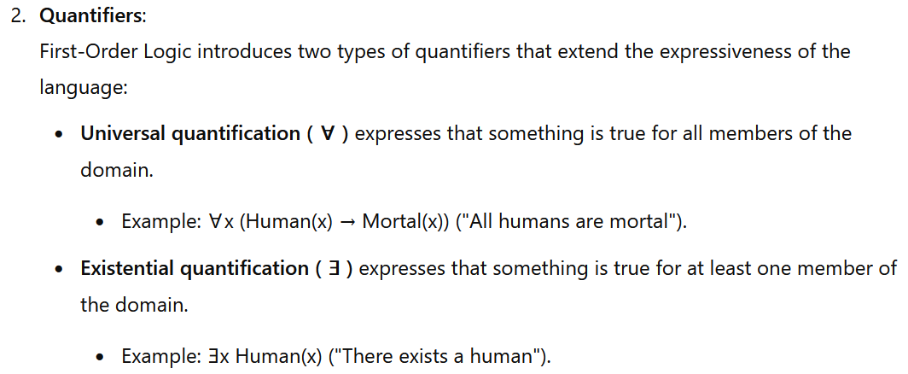
Key Components of FOL Knowledge Engineering

Slide 93
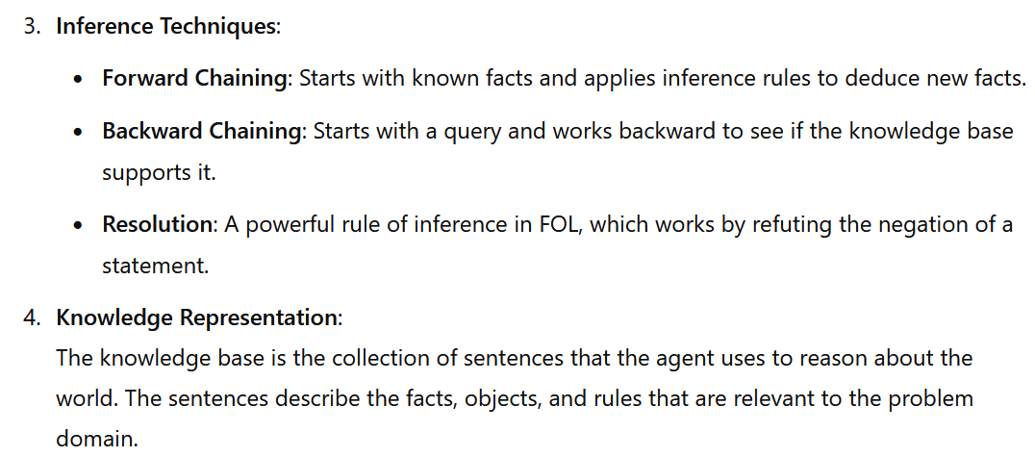

Slide 94
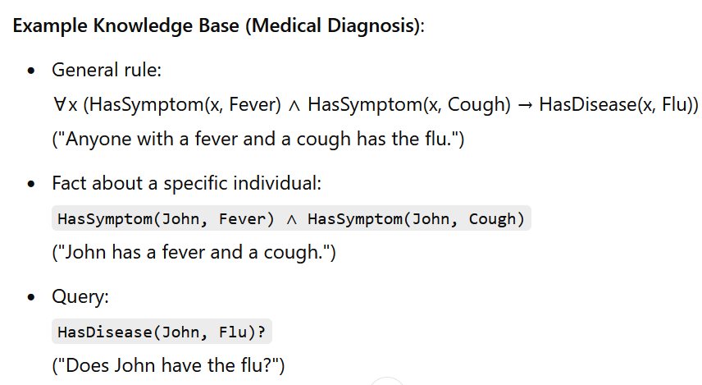

Slide 95
Inference in FOL
In FOL, inference can be defined as
the process of deriving new sentences or conclusions from existing sentences in a knowledge base.
FOL allows more expressive representations of knowledge using constants, functions, predicates, and quantifiers (both universal ∀ and existential ∃).
The goal of inference is to derive new knowledge or prove statements given the facts and rules in the knowledge base.

Slide 96
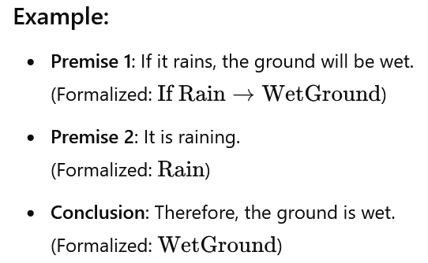
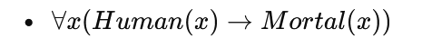
Basic Inference Rules in FOL
Modus Ponens (Implication Elimination)
2. Universal Elimination (Instantiation)
Given a universally quantified sentence, you can substitute a specific instance for the variable. For example:

Slide 97

Basic Inference Rules in FOL
3. Existential Elimination
Given an existentially quantified sentence, we can infer a specific instance exists but introduce a new constant (called a Skolem constant) to replace the existential variable
4. Existential Introduction
If you know a particular instance is true, you can generalize to an existential quantification:

Slide 98
v. Unification:
Unification is finding substitutions for variables that make different logical expressions look identical. This is essential for inference algorithms that involve matching patterns in knowledge bases.
Example:
Consider two logical predicates:
loves(John,X)
loves(Y,Mary)
The goal is to unify these two predicates by finding substitutions for the variables X and Y that make the two expressions identical.
Final Substitution:
Y=John
X=Mary
After applying these substitutions, both expressions become: loves(John, Mary)

Slide 99
Vi) Generalized Modus Ponens:
Extends propositional modus ponens by allowing substitution of terms in FOL sentences.
For example,
if Loves(John, x) and
x = Mary,
we can infer Loves(John, Mary).
Vii) Resolution:
In first-order logic (FOL), resolution is an inference technique used to refute a statement by proving that its negation leads to a contradiction.
Resolution is commonly used in automated theorem proving.

Slide 100
Resolution Process:
Convert to Clausal Form: Convert all sentences into Conjunctive Normal Form (CNF). This involves eliminating implications and equivalences, moving quantifiers, and creating disjunctions of literals.
Negate the Goal: To prove a statement, the first step is to negate the statement and add it to the knowledge base. The goal is to derive a contradiction, which will prove the original statement.
Apply Resolution Rule: Use unification and the resolution rule to derive new clauses by resolving pairs of clauses that contain complementary literals.
Derive Contradiction: If we can derive the empty clause, this indicates that the negation of the goal led to a contradiction, meaning the original statement must be true.

Slide 101
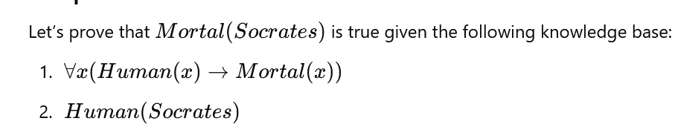

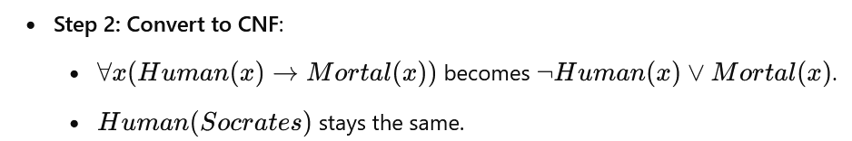
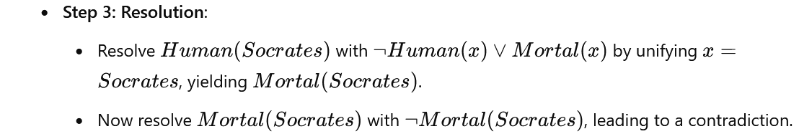
Resolution-Example

Slide 102
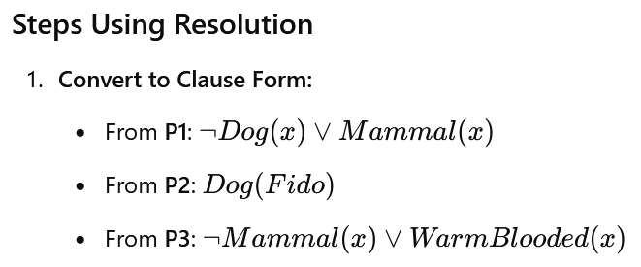
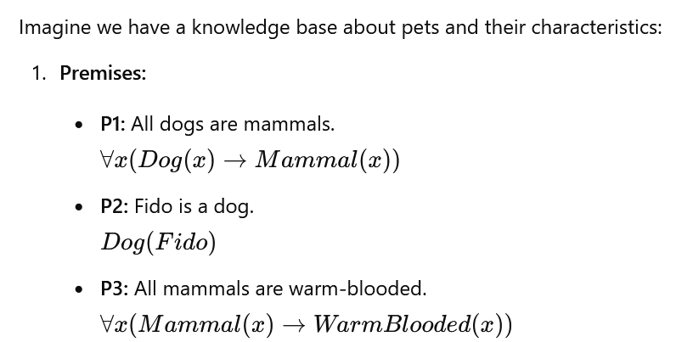



Example Resolution:

Slide 103
The expressiveness of First-Order Logic
FOL is significantly more powerful than propositional logic because it can represent:
Relationships between objects.
Example: Parent(John, Mary) (John is the parent of Mary).
Quantification over objects.
Example: ∀x Loves(x, IceCream) (Everyone loves ice cream).
In contrast, propositional logic can only handle simple true/false statements without the ability to express detailed relationships or general rules involving quantification.

Slide 104
FOL Example:
Knowledge Base: A set of statements in FOL about the world.
Example: 1
∀x (Student(x) → (∃y (Teacher(y) ∧ Teaches(y, x)))) ("For every student, there exists a teacher who teaches them.")
∀x (Student(x) → ∃y (Teaches(y, x) ∧ Likes(x, y))) ("Every student likes some teacher that teaches them.")
With these statements, an AI system can reason about specific students and teachers, infer new facts, and answer queries.

Slide 105
Example:
∀x (Cat(x) → Animal(x)) (“All cats are animals”).
∀x (Animal(x) → Breathes(x)) (“All animals breathe”).
Cat(Garfield) (“Garfield is a cat”).
From this knowledge base, an inference engine can derive that Garfield is an animal and that Garfield breathes.

Slide 106
Limitations of First-Order Logic
Though FOL is a powerful tool for AI systems, it has certain limitations:
Undecidability:
It is not always possible to algorithmically determine whether a given statement in FOL is true or false within a given knowledge base. In other words, FOL is semidecidable: if a statement is true, an algorithm can prove it, but if it is false, the algorithm might run forever.
Expressive, but Not Always Practical:
FOL is more expressive than propositional logic, but the more expressive a system, the more computationally expensive it becomes. For large and complex domains, reasoning in FOL can become computationally intractable.
Closed-World Assumption:
Many systems using FOL operate under the closed-world assumption, meaning they assume that anything not explicitly stated to be true is false. In contrast, in many real-world situations, the open-world assumption holds, meaning that a fact could be true even if it’s not stated in the knowledge base.

Slide 107




Forward chaining
Example:

Slide 108

Algorithm: Forward chaining

Slide 109
Backward chaining
is a goal-driven reasoning process.
It starts with a goal or query and works backward, trying to find rules that could lead to the goal.
It recursively tries to prove the premises of these rules until it reaches known facts.
It is often used in systems where we want to answer specific queries, as backward chaining focuses only on facts relevant to the query.

Slide 110



Slide 111
Backward chaining Algorithm
Start with a goal (query).
If the goal is a known fact, it succeeds.
Otherwise, find a rule whose conclusion matches the goal.
Attempt to prove the premises of the rule using backward chaining recursively.
If all premises are proven, the goal is proven.

Slide 112
Types of Reasoning
Monotonic Reasoning:
Once the conclusion is taken, then it will remain the same even if we add some other information to existing information in our knowledge base.
Monotonic reasoning is used in conventional reasoning systems, and a logic-based system is monotonic.
Any theorem proving is an example of monotonic reasoning.
Example:
Earth revolves around the Sun.
It is a true fact, and it cannot be changed even if we add another sentence in knowledge base like, "The moon revolves around the earth" Or "Earth is not round," etc.

Slide 113
Types of Reasoning
Advantages of Monotonic Reasoning
Each old proof will always remain valid.
If we deduce some facts from available facts, then it will remain valid for always.
Disadvantages of Monotonic Reasoning
We cannot represent the real world scenarios using Monotonic reasoning (since facts are changing every time).
Hypothesis knowledge cannot be expressed with monotonic reasoning, which means facts should be true.
Since we can only derive conclusions from the old proofs, so new knowledge from the real world cannot be added.

Slide 114
Types of Reasoning
Non-monotonic Reasoning:
Some conclusions may be invalidated if we add some more information to our knowledge base.
Non-monotonic reasoning deals with incomplete and uncertain models.
"Human opinions for various things in daily life, "is a general example of non-monotonic reasoning.
Example:
Birds can fly
Penguins cannot fly
Pitty is a bird
We can conclude that Pitty can fly.
If we add one another sentence, "Pitty is a penguin", which concludes "Pitty cannot fly", so it invalidates the above conclusion.

Slide 115
Types of Reasoning
Advantages of Non-monotonic Reasoning
For real-world systems such as Robot navigation, we can use non-monotonic reasoning.
In Non-monotonic reasoning, we can choose probabilistic facts or can make assumptions.
Disadvantages of Non-monotonic Reasoning
In non-monotonic reasoning, the old facts may be invalidated by adding new sentences.
It cannot be used for theorem proving.

Slide 116
Uncertain Reasoning
Unfortunately the world is an uncertain place.
Any AI system that seeks to model and reason in such a world must be able to deal with this.
In particular it must be able to deal with:
Incompleteness – compensate for lack of knowledge.
Inconsistencies – resolve ambiguities and contradictions.
Change – it must be able to update its world knowledge base over time.
Clearly in order to deal with this some decision that a made are more likely to be true (or false) than others and we must introduce methods that can cope with this uncertainty.

Slide 117
Symbolic Reasoning under Uncertainty
We have described techniques for reasoning with a complete, consistent and unchanging model of the world.
But in many problem domains, it is not possible to create such models.
So here we are going to explore techniques for solving problems with incomplete and uncertain models.

Slide 118
Symbolic Reasoning under Uncertainty
At times we must maintain many parallel belief spaces, each corresponding to one agent’s beliefs.
Conventional Reasoning Systems: Such as First-Order Predicate Logic (FOPL) are designed to work with information that has three important properties.
- It is complete concerning the domain of interest.
- It is consistent.
- The only way it can change is that new facts can be added as they become available.
If any of these properties are unsatisfied, conventional logic-based reasoning systems become inadequate.
Non monotonic reasoning systems, are designed to be able to solve problems in which all of these properties may be missing.

Slide 119
Logics for Non-Monotonic Reasoning
We would like to find a formalism that does all of the following things:
- Defines the set of possible domains that could exist given the facts that we do have.
- More precisely, we will define an interpretation of a
- set of Well-formed formulas (wff’s) to be a domain (a set of objects), together with a function that assigns; to each predicate, a relation.
- to each n-ary function, an operator that maps from D’’ to D; and to each constant, an element of D.
- A model of a set of wff’s is an interpretation that satisfies them.

Slide 120
Logics for Non-Monotonic Reasoning
Provides a way to say that we prefer to believe in some models rather than others.
Provides the basis for a practical implementation of this kind of reasoning.
Corresponds to our intuitions about how this kind of reasoning works.
Here we want to draw conclusions based on what is most likely to be true.

Slide 121
Logics for nonmonotonic reasoning are 2 types
Default Reasoning
2 approaches: i) Non monotonic Logic ii) Default Logic
Minimalist reasoning
2 approaches: i) Closed world assumption ii) Circumscription

Slide 122
Default Reasoning
This is a very common form of non-monotonic reasoning.
Here we want to draw conclusions based on what is most likely to be true. (based on available information, a particular outcome or statement has a high probability of being accurate,)
Two Approaches to do this
◦ Non-Monotonic Logic
◦ Default Logic
Non-Monotonic reasoning is generic descriptions of a class of reasoning.
Non-Monotonic logic is a specific theory.
The same goes for Default reasoning and Default logic.

Slide 123
Default Reasoning
Non-Monotonic Logic
The truth of the proposition may change when new information is added and logic may be built to allow the statement to be retracted.
This is an extension of first-order predicate logic to include a modal operator, M. The purpose of this is to allow for consistency.
states that for all x is x plays an instrument and if the fact that x can improvise is consistent with all other knowledge then we can conclude that x is a jazz musician.

Slide 124
Default Reasoning
How do we define consistency?
One common solution (consistent with PROLOG notation) is

Slide 125
Default Reasoning
2. Default Logic
It expresses facts like“ by default something is true”
Standard logic: can only express that something is true or that something is false.
This is a problem because reasoning often involves facts that are true in the majority of cases but not always.

Slide 126
Default Reasoning
Example of default logic: “ Birds typically fly”
This is expressed in standard logic like
i) “All birds fly”-> This is inconsistent with fact that penguins do not fly
ii) All birds that are not penguins and not ostriches and -------- fly-> this requires all exceptions to the rule to be specified.

Slide 127

Default Reasoning
Default logic aims at formalizing inference rules without explicitly mentioning all their exceptions
Default logic introduces a new inference rule:
A= prerequisite
B = Justification
C = Consequent
Read as “ If A is provable and it is consistent to assume B then conclude C”

Slide 128

Default Reasoning

Slide 129
Minimalist Reasoning
The idea behind using minimal models as a basis for non-monotonic reasoning about the world is the following –
There are many fewer true statements than false ones.
If something is true and relevant it makes sense to assume that it has been entered into our knowledge base.
Therefore, assume that the only true statements are those that necessarily must be true to maintain consistency.
There are two kinds of minimalist reasoning
The Closed World Assumption
Circumscription

Slide 130
Minimalist Reasoning
1) Closed World Assumption
The Closed World Assumption (CWA) is the assumption that what is not known to be true, is false, so the absence of information is interpreted as negative information.
It implies in a knowledge base if the ground literal P(a) is not provable then ~P(a) is assumed to hold true.
CWA says that only objects that satisfy any predicate P are must.
CWA: beat for database, For example: Company’s employee database, Airline system etc.
CWA applies when a system has complete information
Ex: Example: Given :Given: Yossi is a citizen of Israel Question: Is Yossi a citizen of USA?
Answer: CWA : NO

Slide 131
Example 2: Database application: Airlines
If you are looking for a direct flight between Bangalore and China, and if does not exists in the database then the result is
“ There is no flight between Bangalore and China”.
For this kind of application, this is expected and correct answer.

Slide 132
Drawbacks:
Assumptions are not always true in the world. Some parts of the world are not realistically closable.
Example: Unrevealed facts in the murder case

Slide 133
2. Circumscription
is a non-monotonic logic created by John McCarthy to formalize the common-sense assumption that things are as expected unless otherwise specified.
Circumscription (Restriction): Is a rule of conjecture (conclusion formed based on incomplete information) that allows you
- to jump to the conclusion that the objects you can show that posses a certain property, p, are all the objects that possess that property.
Circumscription can also cope with default reasoning.
Circumscription together with first-order logic allows a form of Non-monotonic Reasoning.

Slide 134
Example: Suppose a child knows only 2 birds parrot and a sparrow
Bird(parrot) v Bird(sparrow)
Define a rule:
∀ x Bird(x) -> Bird(parrot)v Bird(sparrow)
∀ x: Bird(x)-> (x = parrot v x =sparrow)

Slide 135

Thank You

